Slide 1





Smart Click
Multi-Location Wireless Light Switch

Slide 2
Objectives
1. Popularized home automation/ Smart home concept.
2. Create room integration with simple steps.
3. Provide affordable product in the market.
4. Accessible, stable, and secure smart phone.

Slide 3
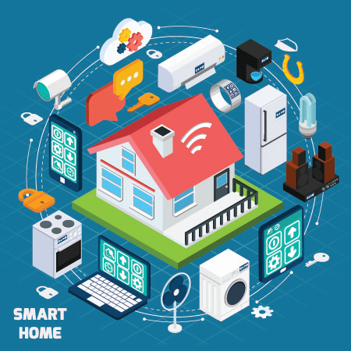

Context
Home Automation
Internet of things
Notes:
This is configuration architecture.

Slide 4
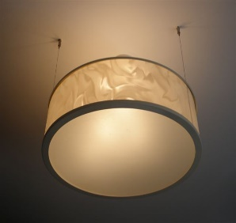
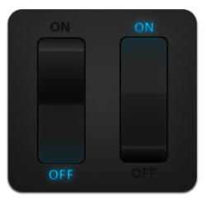
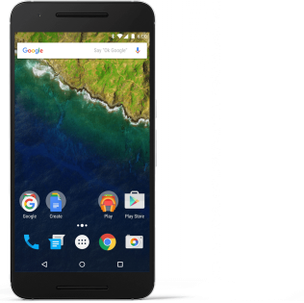
Our project
The product service consists of 3 parts:
Switch ability, turning the switch into the desirable position using wireless element. User does not have the need for physical contact with the switch.
Scheduling time, setting up alarm and configure the live-time for the light. We consider this feature to be beneficial for user that can not sleep without light but also want to save electricity.
Dashboard, on this feature user can list switch that is controlled using the application and see the status of it.

Slide 5
Areas of impact
Middle Class Family
Restaurant
KTV
Hotel
Inn

Slide 6


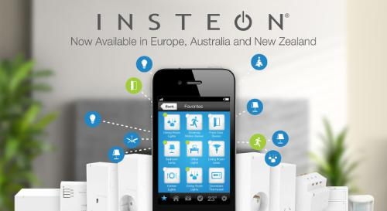
Some big brand

Slide 7


